Slide 1
Penalty Monitor for Violating Traffic Rules using Cloud Computing
TEAM MEMBERS
Dwarakeshwaran B M - 723715104006
Manikandan M - 723715104021
ManojPrabhu D - 723715104025
Raghin R - 723715104039
TEAM GUIDE
Mr. R. Chandrasekar (HOD/CSE)

Slide 2
ABSTRACT
Digitalizing the normal paper receipt.
Monitoring individual traffic rule violators.
Store the information over the offenders and their cases.
Using DataBase-as-a-Service, provided by Firebase for faster retrieving of data.
Aadhar Number is used for authentication and security purposes.

Slide 3
OBJECTIVE
To digitalize the receipt provided by traffic inspectors and information about the corresponding traffic violators.
To manage a dedicated centralized database using JSON for faster storing and retrieval of data.
To provide notification for the offenders about their fine payment.
To provide a simple method of client server architecture.
To generate dynamic webpages for real-time viewing of data.

Slide 4
EXISTING SYSTEM
In existing system, only manual writing in a challan is practiced.
Acknowledgement is not provided digitally.
No accurate database records for traffic violations.

Slide 5
PROPOSED SYSTEM
To avoid fraudulent activities and to regulate the process of fining traffic violators.
Acknowledgement is provided.
Complete database is maintained and also produces accurate results.

Slide 6
LITERATURE SURVEY
No. | Name | Description | Pros | Cons
1. | Study on Google Firebase for Website Development. (The real time database) (Hari Shankar Sing and Uma Shankar Singh) | Firebase is a “NoSQL” database which are useful for large sets of distributed data. NoSQL databases are effective for big data performance issues that relational databases aren't built to solve. | •Scalable. •Hierarchical Storage . | •Internet Connection is needed.
2. | Application of Firebase in Android App Development -A Study. (Chunnu Khawas and Pritam Shah) | The server used for Android apps are Oracle SQL, Microsoft SQL Server, and MySQL which are connected to the server with PHP files. Then Firebase came into existence for Android apps which uses JSON for storing data. | Has real-time and cloud-based database where you can store data is JSON and synchronized continuously. | Querying and aggregating are limited compared to SQL

Slide 7
LITERATURE SURVEY
No. | Name | Description | Pros | Cons
3. | Retrieve Real-time Data in Android Using Firebase. ( Shravan I.V. ) | Firebase is a cloud based platform for mobile and Web application development. Explains how to use Firebase’s cloud services to store and retrieve real-time data. | Realtime / streaming updates are pretty easy. The data structure is JSON which maps perfectly to UI JavaScript. | Firebase is somewhat deprecated in favor of Cloud Firestore.
4. | Making It Work for Everyone: HTML5 and CSS Level 3 for Responsive, Accessible Design on Website. (Stewart C. Baker) | The bulk of the article explains the design philosophies of progressive enhancement and responsive web design, and summarizes recent updates HTML5 and CSS Level 3. | Canvas Element. Allows storing files or web application makes them accessible without internet connectivity. | Considerable effort even if wishes to carry out a minor change in the site. Not all browsers support HTML5 which is being counted as the major drawback.

Slide 8
LITERATURE SURVEY
No. | Name | Description | Pros | Cons
5. | A Comprehensive analysis of XML and JSON web technologies. (Zia Ul Haq, Gul Faraz Khan and Tazar Hussain) | XML and JSON is compared in different aspects and then on the basis of these comparisons conclusion has been derived that which technology is required for whom and for what purpose. | Concise format thanks to name/value pair -based approach. | No namespace support, hence poor extensibility.
6. | Android Based Mobile Application Development And Its Security. (Suhas Holla and Mahima M Katti) | Android mobile platform for the mobile application development, layered approach and the details of security information for Android is discussed. | Budget-friendly option. | Endangering data privacy.

Slide 9
LITERATURE SURVEY
No. | Name | Description | Pros | Cons
7. | Database in Cloud Computing - Database-as-a Service (DBaas) with its Challenges. (Shweta Dinesh Bijwe and Prof. P. L. Ramteke) | A DBaaS promises to move much of the operational burden of provisioning, configuration, scaling, performance tuning, backup, privacy, and access control from the database users to the service operator, offering lower overall costs to users. | The database is off site, meaning loss of power or natural disaster at your business doesn’t affect it. | Don’t have direct access to the servers that are running your database.
8. | Cloud Database - Database As A Service. (Waleed Al Shehri) | The structure of database in cloud computing and its working in collaboration with nodes is observed under database as a service. | The DBaaS model can also help reduce data and database redundancy and improve overall Quality of Service. | Database doesn't support features such as data compression and table partitions.

Slide 10
LITERATURE SURVEY
No. | Name | Description | Pros | Cons
9. | QR Code Scanning app for Mobile Devices. (Mircea Moisoiu, Andrei Negrau, Robert Gyorodi, Cornelia Gyorodi and George Pecherle ) | Present an implementation of an Android device using libraries and combined algorithms in order to be able to scan any QR code fast accurate and easy. | Ease of use. Range of uses. QR codes are traceable. | Dependability on a mobile device or Smartphone. Lack of awareness.
10. | A Comparative Study between Dynamic Web Scripting Languages. ( Alok Ranjan, Rajeev Kumar and Joydip Dhar ) | Compared the impacts of these three languages on the performance of a web server.Have described and analyzed the results of conducting experiments on four benchmarks. | Dynamic content generated for each user. Easy to update with a CMS like Wordpress. More powerful with features like login, payments, etc. | Expensive -setting up, maintaining, and scaling a database is costly. Complex - much more steps involved to setup and deploy than a static site.

Slide 11
LITERATURE SURVEY
No. | Name | Description | Pros | Cons
11. | A Comparative Study of Web Development Technologies Using Open Source and Proprietary Software. (David A. Botwe and Joseph G. Davis) | Presents a comparison of web application development technologies using open source software and proprietary software. | The source code is not shared with the public for anyone to look at or change. | Many people have access to the source code of open source software, but not all of them have good intentions.
12. | Mobile Application Development: All the Steps and Guidelines for Successful Creation of Mobile App: Case Study. (Kishore Baktha) | Numerous factors that can play a significant role in successful app development are discussed with specific examples and explanation. | Compatibility. Support and Maintenance. | Offline. Access Convenience.

Slide 12
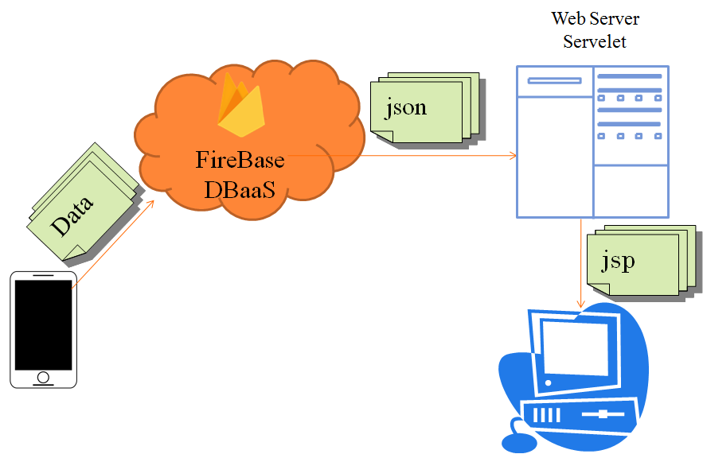
ARCHITECTURE DIAGRAM

Slide 13
HARDWARE & SOFTWARE REQUIREMENTS
Android App
Android Studio
Emulator – AVD
Linux OS (MINT)
Firebase
Linux OS (MINT)
Website
Windows 7 Ultimate
Eclipse
Sublime Text Editor

Slide 14
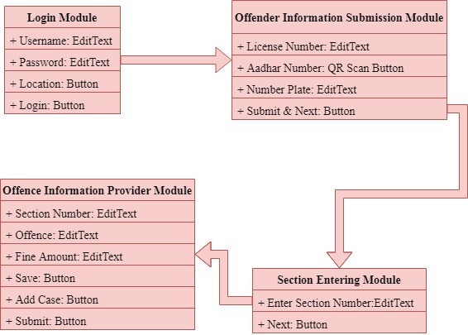
OVERVIEW OF MOBILE APP

Slide 15
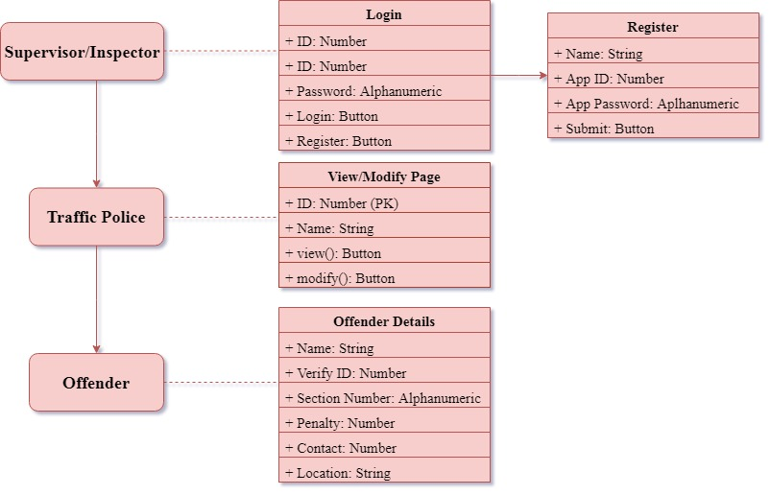
OVERVIEW OF WEBSITE

Slide 16

MODULES
Login Module:
The Traffic Inspector is prompted to enter his/her App ID and App Password provided by the Supervisor in the website registration.

Slide 17
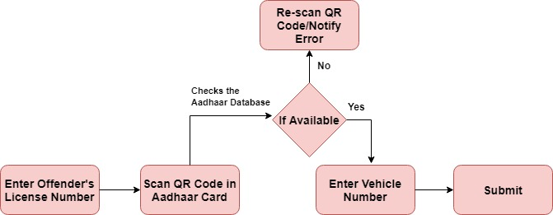
MODULES
Offender Information Submission Module:
The Traffic rules violator’s information gets checked and stored in this module. QR Scanning is used here for checking the aadhar details of the offender.

Slide 18
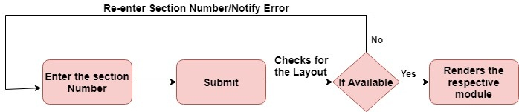
MODULES
Section Entering Module:
Every Traffic Violation has a specific Section Number. By providing the offender related section number, it will guide the traffic inspector to the corresponding Offence information submission module.

Slide 19
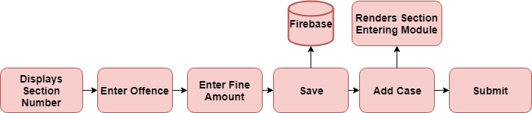
MODULES
Offence Information Submission Module:
The information of the Offence gets recorded and stored here in this module.

Slide 20
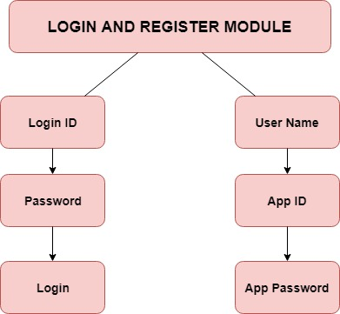
MODULES
Login and Register Module:
The Supervisor has the authority over this module (Web Page).
He /She can add inspectors and give them their specific App ID and App Password.

Slide 21
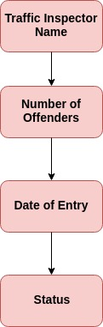
MODULES
View/Modify Module:
Displays the contents of each Inspector.
The supervisor can click on any inspector to view the details of the offender.
The Inspector’s details stored in MySql Database is are retrieved by a PHP script.

Slide 22
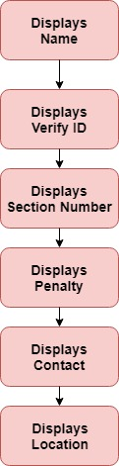
MODULES
Offender Information Module:
Offender’s informations are displayed here in this module.
It retrieves the JSON data from the Firebase Database and displays the HTML content in this dynamic web page.

Slide 23
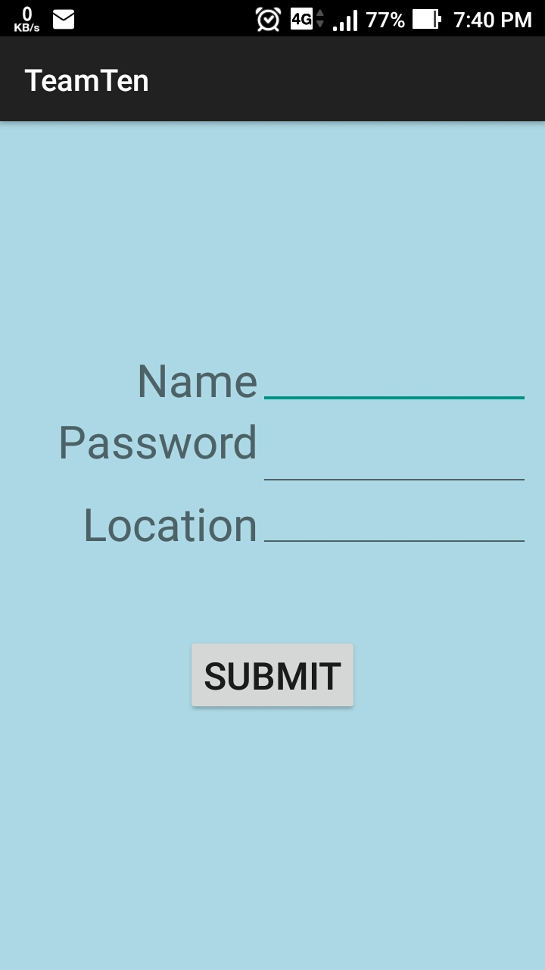
OUTPUT
The following screenshots includes four App Module Activities and three Website Module Activities.
The App Modules are build using Android Studio’s Gradle Build.
The Website Modules are generated using Eclipse IDE.

Slide 24
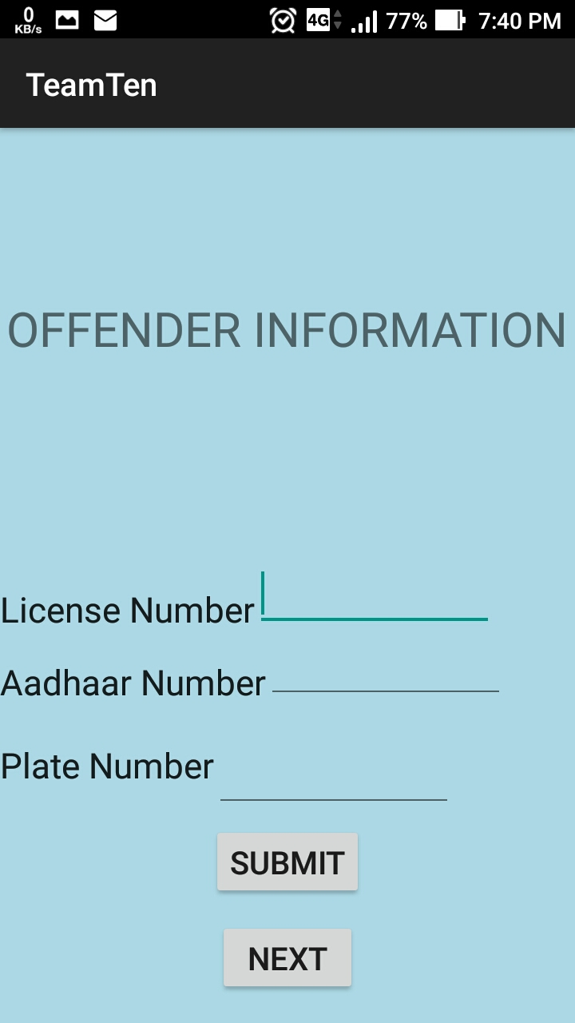
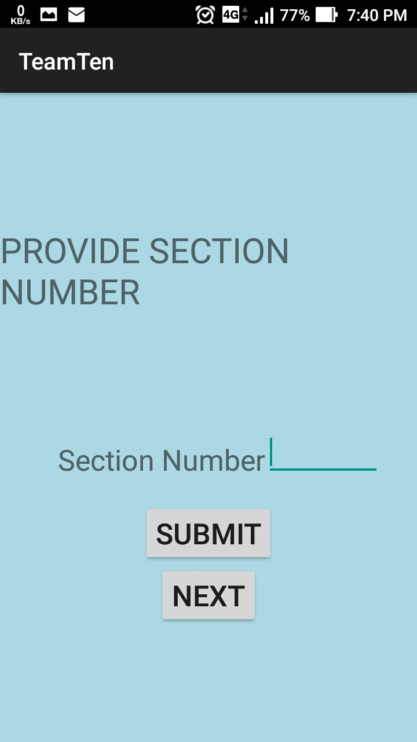
OUTPUT

Slide 25
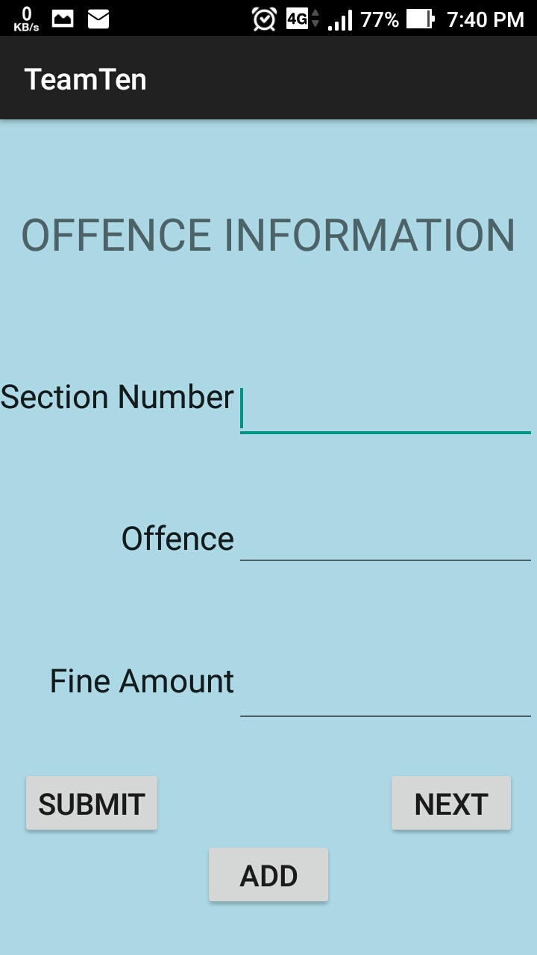
OUTPUT

Slide 26
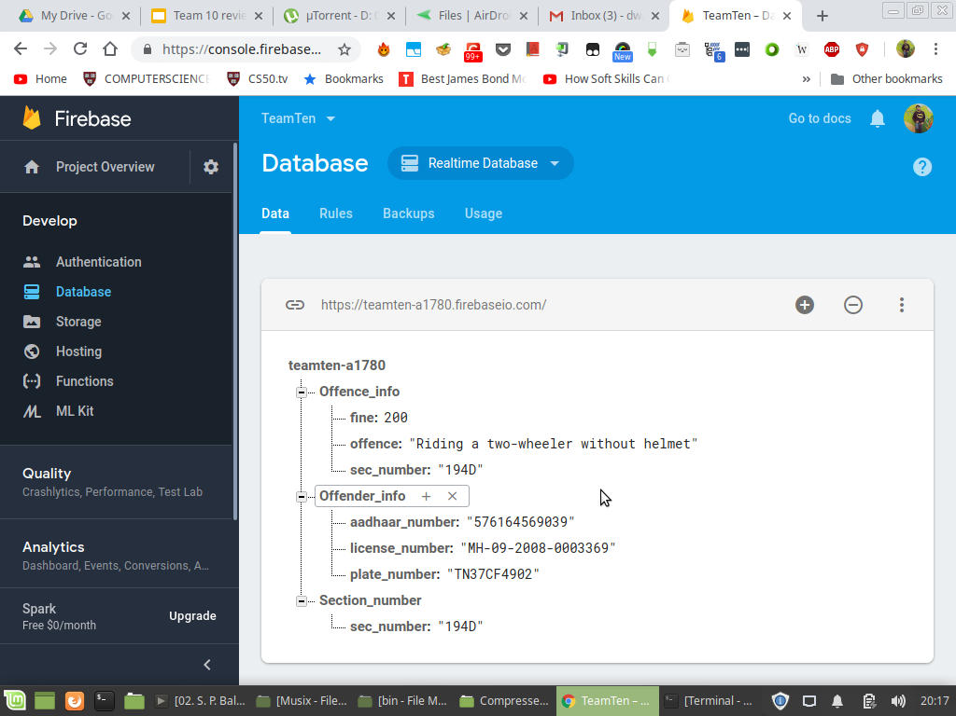
OUTPUT

Slide 27
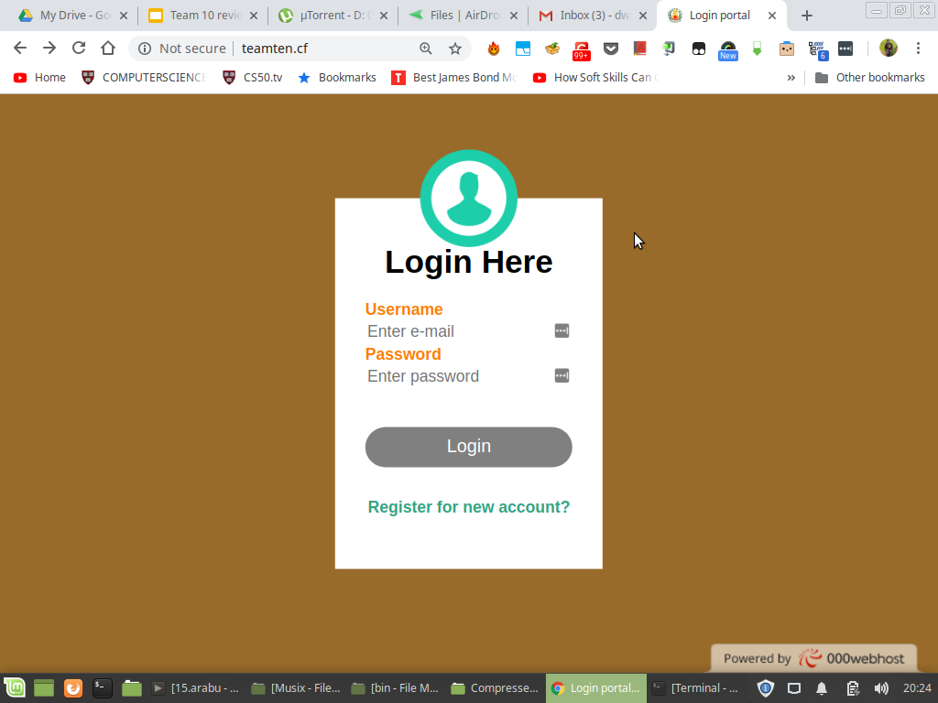
OUTPUT

Slide 28
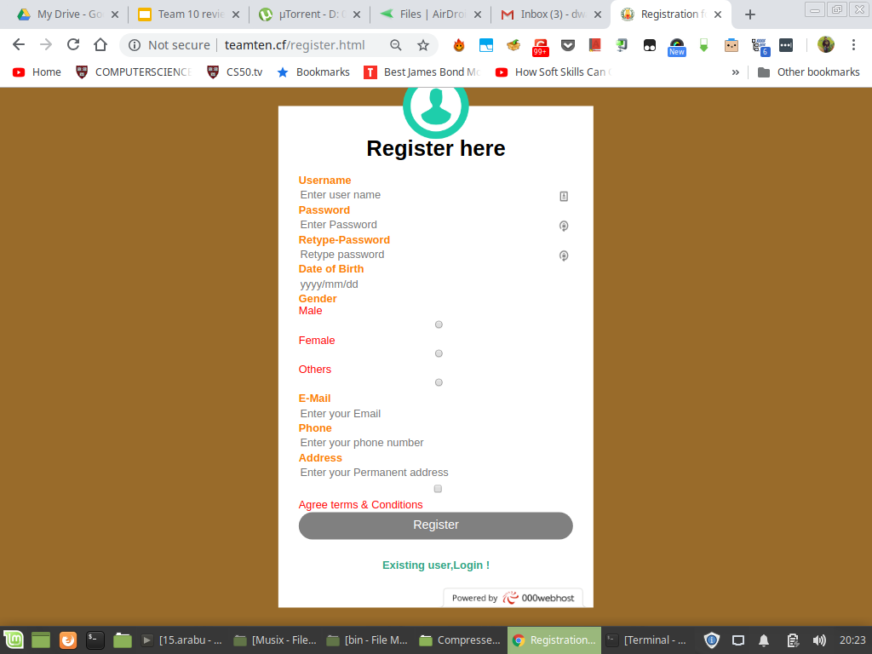
OUTPUT

Slide 29
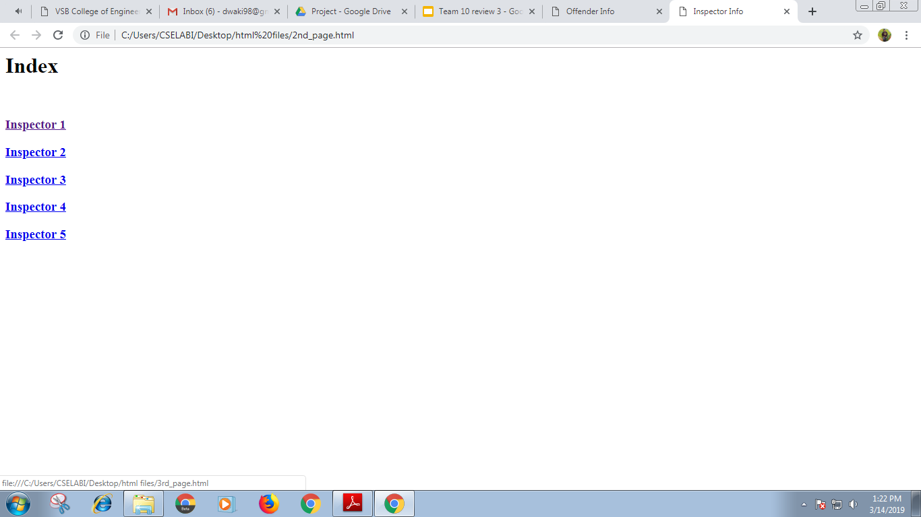
OUTPUT

Slide 30
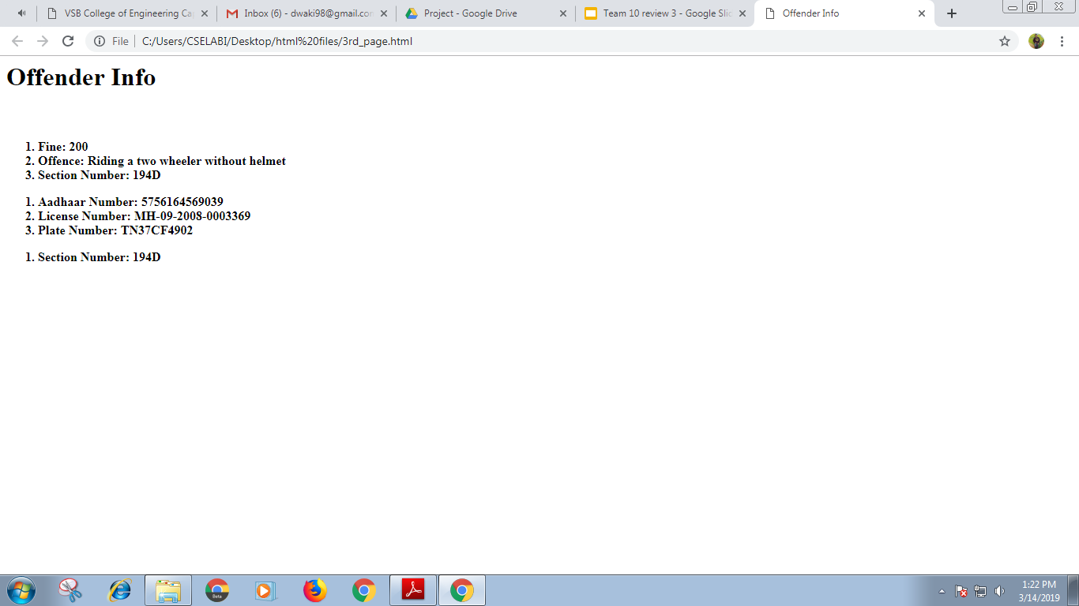
OUTPUT

Slide 31
CONCLUSION
Monitoring the traffic records is an important job to do.
Using realtime database makes the retrieval of data faster and it does the job more efficiently than the traditional techniques.
Feature like QR Scanning eases the process of identification of offenders.
Implementation is easier and it reduces the job of traffic inspectors to a greater extent.

Slide 32
REFERENCE
[1]. Chunnu Khawas, Pritam Shah -Journal International of
Computer Applications (0975 – 8887) Volume 179 – No.46,
June 2018 Application of Firebase in Android App
Development-A Study.
[2]. Stewart Baker- Making It Work for Everyone: HTML5 and
CSS Level 3 for Responsive, Accessible Design on
your Library’s ,Website Western Oregon University,
bakersc@wou.edu.
[3]. Zia Ul Haq , Gul Faraz Khan, Tazar Hussain-A
Comprehensive analysis of XML and JSON web technologies

Slide 33
REFERENCE CONTD.
[4]. Suhas Holla, Mahima M Katti- Android Based Mobile
Application Development and its SECURITY, International
Journal of Computer Trends and Technology- volume3Issue3-
2012.
[5]. Arthur Charguéraud Inria & Université de Strasbourg,
CNRS, ICube UMR 7357 arthur.chargueraud@inria.fr Alan
Schmitt Inria & Univ Rennes, CNRS, IRISA
alan.schmitt@inria.fr Thomas Wood Imperial College London
thomas.wood09@imperial.ac.uk- JSExplain: a Double
Debugger for JavaScript.

Slide 34
REFERENCE CONTD.
[6]. P. C. van Oorschot, A. Salehi-Abari, and J. Thorpe.Purely
automated attacks on PassPoints-style graphical passwords.
IEEE Trans. Info. Forensics and Security, 5(3):393–405, 2010.
[7]. D. Kim, P. Dunphy, P. Briggs, J. Hook, J. Nicholson,J.
Nicholson, and P. Olivier. Multi-touch authentication on
tabletops. In 28th ACM Conference on Human Factor in
Computing Systems (CHI), pages 1093–1102, Atlanta, USA,
April 2010.
[8]. Ranjan, Alok & Kumar, Rajeev & Dhar, and Joydip. A
Comparative Study between Dynamic Web Scripting
Languages. 10.1007/978-3-642-27872-3_43. January 2012.

Slide 35
REFERENCE CONTD.
[9]. Mircea Moisoiu, Andrei Negrău, Robert Győrödi, Cornelia
Győrödi, George Pecherle. QR Code Scanning app for Mobile
Devices. IJCSMC, Vol. 3, Issue. 6, June 2014, pg.334 – 340.
[10]. Botwe, David & G Davis, Joseph. (2015). International
Journal of Computer Science and Mobile Computing A
Comparative Study of Web Development Technologies Using
Open Source and Proprietary Software. 42. 154-165.
[11]. Kishore Baktha. Mobile Application Development: All the
Steps and Guidelines for Successful Creation of Mobile App:
Case Study. IJCSMC, Vol. 6, Issue. 9, September 2017, pg.15 –20.

